Slide 1
Process Management

Slide 2
What is process?
A process is an active program.
Process means Program in execution.

Slide 3
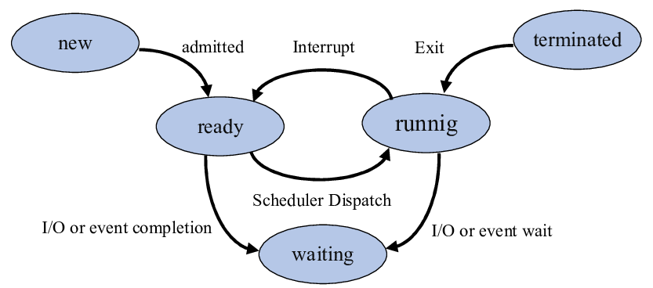
Process State diagram

Slide 4
Process State diagram
New- The process is in new state when it has just been created.
Ready - The process is waiting to be assigned the processor by the short term scheduler.
Running - The process instructions are being executed by the processor.
Waiting - The process is waiting for some event such as I/O to occur.
Terminated - The process has completed its execution.

Slide 5
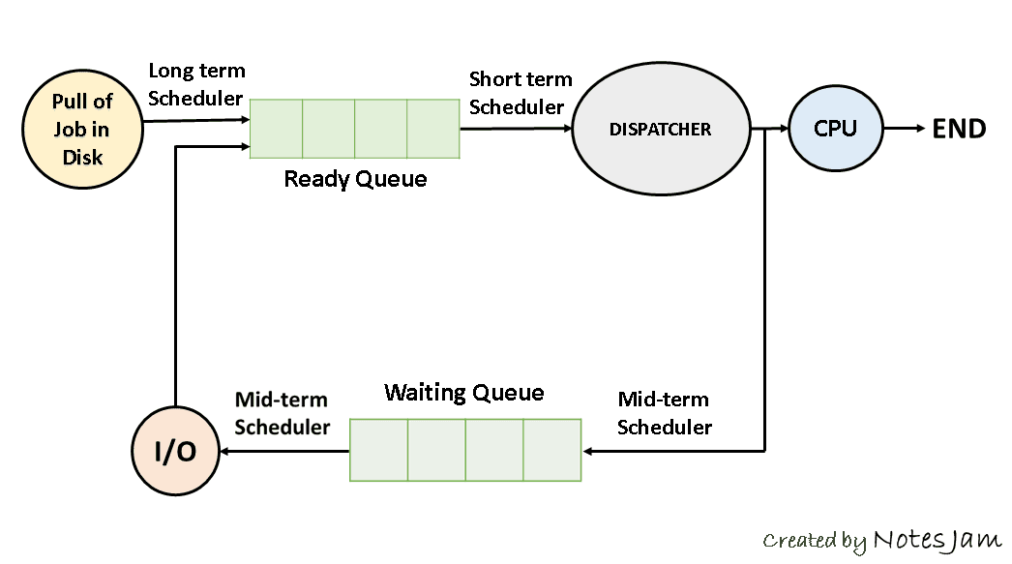
Process Scheduling

Slide 6
Long Term Scheduler
The job scheduler or long term scheduler selects processes from the storage pool and loads them into memory for execution. The job scheduler must select a careful mixture of I/O bound and CPU bound processes to yield optimum system throughput. If it selects too many CPU bound processes then the I/O devices are idle and if it selects too many I/O bound processes then the processor has nothing to do.

Slide 7
Short Term Scheduler
The short term scheduler selects one of the processes from the ready queue and schedules them for execution. The short term scheduler executes much more frequently than the long term scheduler as a process may execute only for a few milliseconds.

Slide 8
Medium Term Scheduler
The medium term scheduler swaps out a process from main memory. It can again swap in the process later from the point it stopped executing. This is helpful in reducing the degree of multiprogramming. Swapping is also useful to improve the mix of I/O bound and CPU bound processes in the memory.

Slide 9
Context Switching
Removing a process from a CPU and scheduling another process requires saving the state of the old process and loading the state of the new process. This is known as context switching. The context of a process is stored in the Process Control Block (PCB) and contains the process register information, process state and memory information.

Slide 10
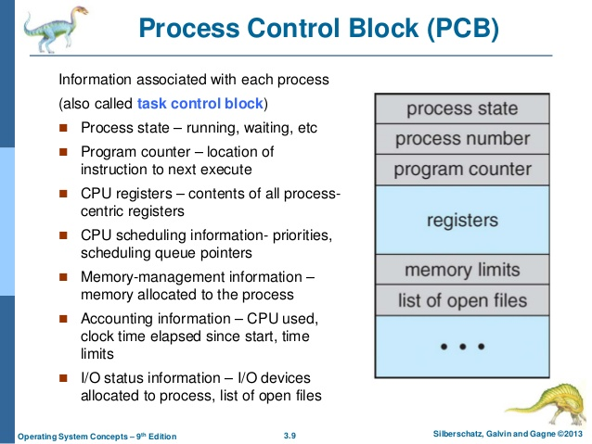
Process Control Block

Slide 11
CPU Scheduling Criteria
CPU utilization – The main objective of any CPU scheduling algorithm is to keep the CPU as busy as possible. Theoretically, CPU utilization can range from 0 to 100 but in a real-time system, it varies from 40 to 90 percent depending on the load upon the system.
Throughput – A measure of the work done by CPU is the number of processes being executed and completed per unit time. This is called throughput. The throughput may vary depending upon the length or duration of processes.

Slide 12
Turnaround Time (TAT):
It is the time interval from the time of submission of a process to the time of the completion of the process.
Difference b/w Completion Time and Arrival Time is called Turnaround Time.

Slide 13
TAT = CT - AT
Completion Time (CT): This is the time when the process completes it’s execution.
Arrival Time (AT): This is the time when the process has arrived in the ready state.
TAT = CT - AT

Slide 14
Waiting Time (WT):
The time spent by a process waiting in the ready queue for getting the CPU.
The time difference b/w Turnaround Time and Burst Time is called Waiting Time.
Burst Time (BT): This is the time required by the process for it’s execution.

Slide 15
Preemptive Scheduling | Non-Preemptive Scheduling
Resources are allocated according to the cycles for a limited time. | Resources are used and then held by the process until it gets terminated.
The process can be interrupted, even before the completion. | The process is not interrupted until its life cycle is complete
starvation may be caused, due to the insertion of priority process in the queue. | Starvation can occur when a process with large burst time occupies the system.
Maintaining queue and remaining time needs storage overhead. | No such overheads are required
SRTF, RR, Priority | FCFS, SJF, Priority

Slide 16
FCFS( First come first serve)
J1(Job) | 15(Execution time)
J2 | 8
J3 | 10
J4 | 3
J1(wj1=0) | J2(wj2=15) | J3(wj3=23) | J4(wj4=33
Average waiting time= Wj1 +Wj2 +Wj3+Wj4= 0+15+23+33=71
71/4=17.75

Slide 17
SJF(Shortest job first)
Job | CPU time
J4(Wj4=0) | 3
J2(Wj2=3) | 8
J3(Wj3)=11 | 10
J1(Wj1)=21 | 15
J4 | J2 | J3 | J1
0 3 | 3 11 | 11 21 | 21 36
Average waiting time= 0 +3+11+21=35/4=8.75

Slide 18
CPU Scheduling Criteria
Turnaround time
Waiting time
Response time :In an interactive system, turn-around time is not the best criteria. A process may produce some output fairly early and continue computing new results while previous results are being output to the user. Thus another criteria is the time taken from submission of the process of request until the first response is produced. This measure is called response time.

Slide 19
Shortest Remaining Time First (SRTF) algorithm
Shortest Remaining Time First (SRTF) is the preemptive version of Shortest Job Next (SJF) algorithm, where the processor is allocated to the job closest to completion.

Slide 20
Shortest Remaining Time First (SRTF) algorithm(Example-1)
Process | Arrival time(AT) | Burst Time(BT) | CT(Completion ) | TAT(CT-AT) | WT(TAT-BT)
P1 | 0 | 8 | 17 | 17 | 9
P2 | 1 | 4 | 5 | 4 | 0
P3 | 2 | 9 | 26 | 24 | 15
P4 | 3 | 5 | 10 | 7 | 2
 |  |  |  | 52 | 26
P1 | P2 | P4 | P1 | P3
0 1
1 5
5 10
10 17
17 26

Slide 21
Shortest Remaining Time First (SRTF) algorithm (Example-1 Continue…)
Average TAT= 52/4=13
Average WT= 26 /4=6.5

Slide 22
Shortest Remaining Time First (SRTF) algorithm(Example-2)
Consider set of process with arrival time (milliseconds), CPU burst time, service . As shown below none of the processes has I/O burst time.
Process.No | A.T | B.T | C.T | T.A.T(CT-AT) | W.T (TAT- BT)
P1 | 0 | 7 | 19 | 19 | 12
P2 | 1 | 5 | 13 | 12 | 7
P3 | 2 | 3 | 6 | 4 | 1
P4 | 3 | 1 | 4 | 1 | 0
P5 | 4 | 2 | 9 | 5 | 3
P6 | 5 | 1 | 7 | 2 | 1
 |  |  |  | 43 | 24
P1 | P2 | P3 | P4 | P3 | P3 | P6 | P5 | P2 | P1
0 1 | 1 2 | 2 3 | 3 4 | 4 5 | 5 6 | 6 7 | 7 9 | 9 13 | 13 19

Slide 23
Calculate average waiting time and turnaround time using SRTF scheduling algorithm
Average TAT= 43/6= 7.16
Average WT= 24/6= 4

Slide 24
Priority Scheduling
Non Preemptive Priority Scheduling:
In the Non Preemptive Priority scheduling, The Processes are scheduled according to the priority number assigned to them. Once the process gets scheduled, it will run till the completion.

Slide 25
Non Preemptive Priority Scheduling( Example-1)
Process ID | Priority | Arrival Time | Burst Time
P1 | 2 | 0 | 3
P2 | 6 | 2 | 5
P3 | 3 | 1 | 4
P4 | 5 | 4 | 2
P5 | 7 | 6 | 9
P6 | 4 | 5 | 4
P7 | 10 | 7 | 10
P1 | P3 | P6 | P4 | P2 | P5 | P7
0 3 | 3 7 | 7 11 | 11 13 | 13 18 | 18 27 | 27 37

Slide 26
Non Preemptive Priority Scheduling( Example-1 continue…..)
Process Id | Priority | Arrival Time | Burst Time | Completion Time | Turnaround Time | Waiting Time | Response Time
P1 | 2 | 0 | 3 | 3 | 3 | 0 | 0
P2 | 6 | 2 | 5 | 18 | 16 | 11 | 13
P3 | 3 | 1 | 4 | 7 | 6 | 2 | 3
P4 | 5 | 4 | 2 | 13 | 9 | 7 | 11
P5 | 7 | 6 | 9 | 27 | 21 | 12 | 18
P6 | 4 | 5 | 4 | 11 | 6 | 2 | 7
P7 | 10 | 7 | 10 | 37 | 30 | 18 | 27
P1 | P3 | P6 | P4 | P2 | P5 | P7
0 3 | 3 7 | 7 11 | 11 13 | 13 18 | 18 27 | 27 37

Slide 27
Preemptive Priority Scheduling
In Preemptive Priority Scheduling, at the time of arrival of a process in the ready queue, its Priority is compared with the priority of the other processes present in the ready queue as well as with the one which is being executed by the CPU at that point of time. The One with the highest priority among all the available processes will be given the CPU next.
The difference between preemptive priority scheduling and non preemptive priority scheduling is that, in the preemptive priority scheduling, the job which is being executed can be stopped at the arrival of a higher priority job.
Once all the jobs get available in the ready queue, the algorithm will behave as non-preemptive priority scheduling, which means the job scheduled will run till the completion and no preemption will be done.

Slide 28
Preemptive Priority Scheduling( Example-1)
P.ID | Priority | A.T | B.T
P1 | 2 | 0 | 4
P2 | 4 | 1 | 2
P3 | 6 | 2 | 3
P4 | 10 | 3 | 5
P5 | 8 | 4 | 1
P6 | 12 | 5 | 4
P7 | 9 | 6 | 6

Slide 29
Preemptive Priority Scheduling( Example-2)
Pid | A.T | B.T | Priority | C.T | T.A.T | W.T
P1 | 1 | 4 | 4
P2 | 2 | 2 | 5
P3 | 2 | 3 | 7
P4 | 3 | 5 | 8
P5 | 3 | 1 | 5
P6 | 4 | 2 | 6

Slide 30
Problem in Priority Scheduling:
Problem in Priority Scheduling:
low priority processes may never execute. This is called starvation.
Solution:
The solution to this starvation problem is aging. In aging, as time progresses, increase the priority of the process so that the lowest priority process gets converted to the highest priority gradually.

Slide 31
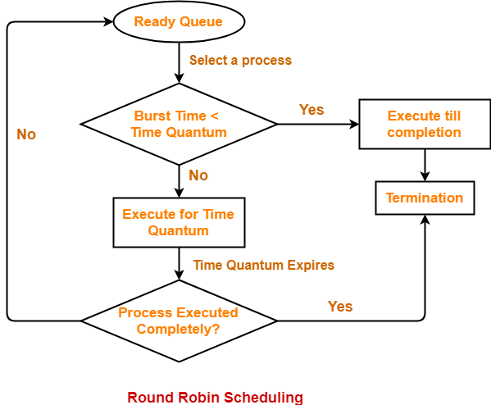
Round Robin scheduling

Slide 32
Round Robin scheduling
Round Robin is the preemptive process scheduling algorithm.
Each process is provided a fix time to execute, it is called a quantum.
Once a process is executed for a given time period, it is preempted and other process executes for a given time period.
Context switching is used to save states of preempted processes.

Slide 33
Round Robin scheduling (Example-1)
Time Quantum=5
Pid | B.T | C.T | TAT | WT
P1 | 21
P2 | 3
P3 | 6
P4 | 2
AVG Waiting time=

Slide 34
Round Robin scheduling (Example-2)
Time quantum =2
Pid | A.T | B.T | C.T | TAT | WT
P1 | 0 | 4
P2 | 1 | 5
P3 | 2 | 2
P4 | 3 | 1
P5 | 4 | 6
P6 | 5 | 3

Slide 35
Multilevel Queue (MLQ) CPU Scheduling
It may happen that processes in the ready queue can be divided into different classes where each class has its own scheduling needs. For example, a common division is a foreground (interactive) process and background (batch) processes. These two classes have different scheduling needs. For this kind of situation Multilevel Queue Scheduling is used.

Slide 36
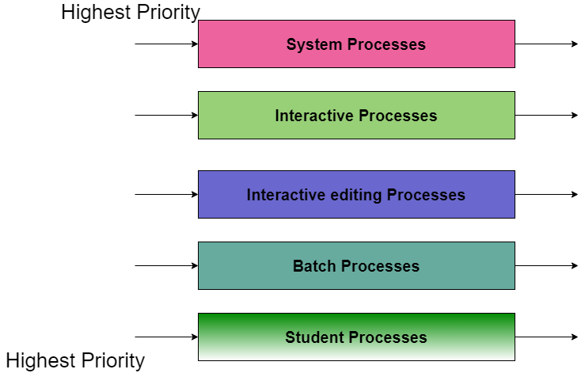
Multilevel Queue (MLQ) CPU Scheduling

Slide 37
Advantages of Multilevel Queue Scheduling
With the help of this scheduling we can apply various kind of scheduling for different kind of processes:
For System Processes: First Come First Serve(FCFS) Scheduling.
For Interactive Processes: Shortest Job First (SJF) Scheduling.
For Batch Processes: Round Robin(RR) Scheduling
For Student Processes: Priority Scheduling

Slide 38
Disadvantages of Multilevel Queue Scheduling
The main disadvantage of Multilevel Queue Scheduling is the problem of starvation for lower-level processes.
Let us understand what is starvation?
Starvation: Due to starvation lower-level processes either never execute or have to wait for a long amount of time because of lower priority or higher priority process taking a large amount of time.

Slide 39
Multilevel Feedback Queue Scheduling
In a multilevel queue-scheduling algorithm, processes are permanently assigned to a queue on entry to the system. Processes do not move between queues. This setup has the advantage of low scheduling overhead, but the disadvantage of being inflexible.
Multilevel feedback queue scheduling, however, allows a process to move between queues. The idea is to separate processes with different CPU-burst characteristics. If a process uses too much CPU time, it will be moved to a lower-priority queue. Similarly, a process that waits too long in a lower-priority queue may be moved to a higher-priority queue. This form of aging prevents starvation.

Slide 40
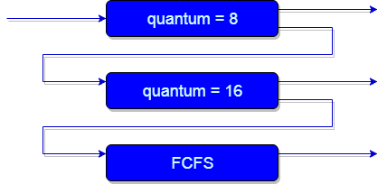
Multilevel Feedback Queue Scheduling

Slide 41
What is Kernel?
Kernel is central component of an operating system that manages operations of computer and hardware. It basically manages operations of memory and CPU time. It is core component of an operating system. Kernel acts as a bridge between applications and data processing performed at hardware level using inter-process communication and system calls.

Slide 42
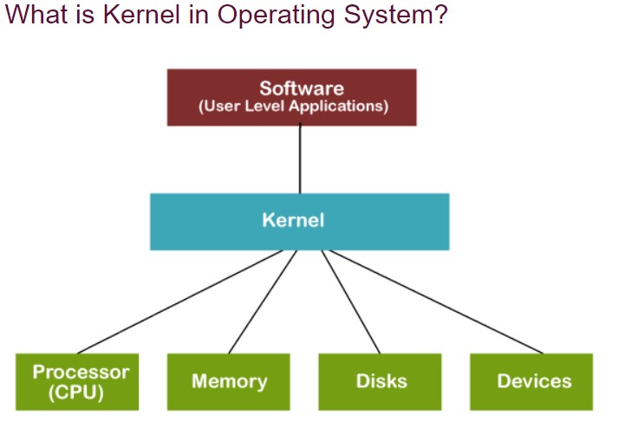
What is Kernel?

Slide 43
System Call
In computing, a system call is the programmatic way in which a computer program requests a service from the kernel of the operating system it is executed on. A system call is a way for programs to interact with the operating system. A computer program makes a system call when it makes a request to the operating system’s kernel. System call provides the services of the operating system to the user programs via Application Program Interface(API).

Slide 44
System Call
Services Provided by System Calls :
Process creation and management
Main memory management
File Access, Directory and File system management
Device handling(I/O)
Protection
Networking, etc.

Slide 45
System Call
Types of System Calls : There are 5 different categories of system calls
Process control: end, abort, create, terminate, allocate and free memory.
File management: create, open, close, delete, read file etc.
Device management
Information maintenance
Communication

Slide 46
System Call
Types of System Calls : There are 5 different categories of system calls
Process control: end, abort, create, terminate, allocate and free memory.
File management: create, open, close, delete, read file etc.
Device management
Information maintenance
Communication

Slide 47
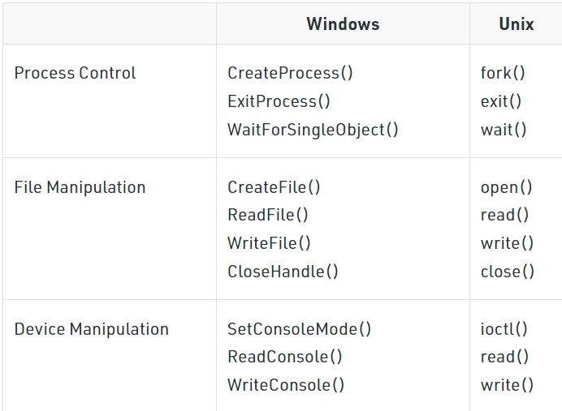
System Call

Slide 48
System Call: fork()
Fork system call is used for creating a new process, which is called child process, which runs concurrently with the process that makes the fork() call (parent process). After a new child process is created, both processes will execute the next instruction following the fork() system call. A child process uses the same pc(program counter), same CPU registers, same open files which use in the parent process.

Slide 49
System Call: fork()
It takes no parameters and returns an integer value. Below are different values returned by fork().
Negative Value: creation of a child process was unsuccessful. Zero: Returned to the newly created child process. Positive value: Returned to parent or caller. The value contains process ID of newly created child process.

Slide 50
What is Thread?
A thread is a path of execution within a process. A process can contain multiple threads.
A thread is a flow of execution through the process code, with its own program counter that keeps track of which instruction to execute next, system registers which hold its current working variables, and a stack which contains the execution history.
A thread shares with its peer threads few information like code segment, data segment and open files. When one thread alters a code segment memory item, all other threads see that.
A thread is also called a lightweight process. Threads provide a way to improve application performance through parallelism. Threads represent a software approach to improving performance of operating system by reducing the overhead thread is equivalent to a classical process.

Slide 51
What is Thread?
Each thread belongs to exactly one process and no thread can exist outside a process. Each thread represents a separate flow of control. Threads have been successfully used in implementing network servers and web server. They also provide a suitable foundation for parallel execution of applications on shared memory multiprocessors. The following figure shows the working of a single-threaded and a multithreaded process.

Slide 52
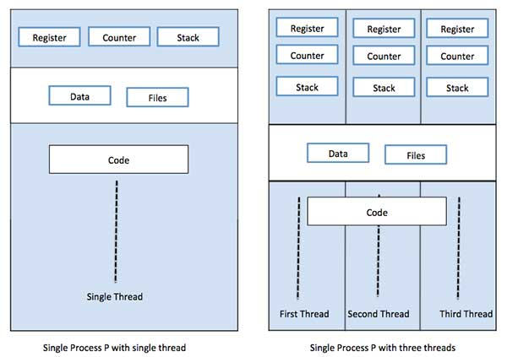
What is Thread?

Slide 53
Difference between Process and Thread
S.N. | Process | Thread
1 | Process is heavy weight or resource intensive. | Thread is light weight, taking lesser resources than a process.
2 | Process switching needs interaction with operating system. | Thread switching does not need to interact with operating system.
3 | In multiple processing environments, each process executes the same code but has its own memory and file resources. | All threads can share same set of open files, child processes.
4 | If one process is blocked, then no other process can execute until the first process is unblocked. | While one thread is blocked and waiting, a second thread in the same task can run.
5 | Multiple processes without using threads use more resources. | Multiple threaded processes use fewer resources.
6 | In multiple processes each process operates independently of the others. | One thread can read, write or change another thread's data.

Slide 54
Advantages of Thread
Threads minimize the context switching time.
Use of threads provides concurrency within a process.
Efficient communication.
It is more economical to create and context switch threads.
Threads allow utilization of multiprocessor architectures to a greater scale and efficiency.

Slide 55
Types of Thread
Threads are implemented in following two ways −
User Level Threads − User managed threads.
Kernel Level Threads − Operating System managed threads acting on kernel, an operating system core.

